Slide 1
STEM FUNDAMENTAL
SESSION NO: 1
TOPIC OF THE DAY: Thaumatrope.
LEARNING TARGET: Persistence of Vision.

Slide 2
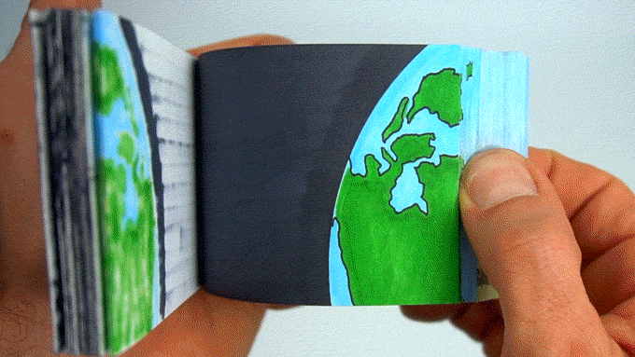
Flip Book

Slide 3
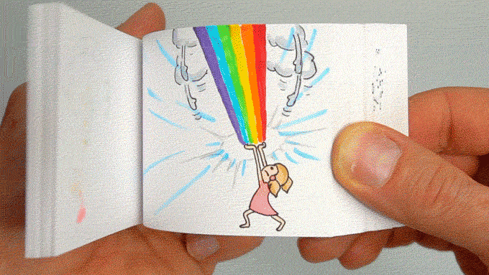
Flip Book

Slide 4
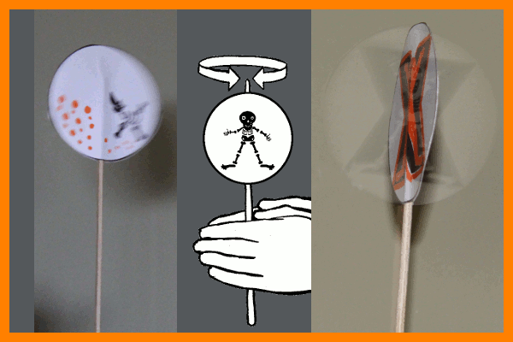
Thaumatrope
A Thaumatrope is a disk with a picture on each side which is attached to two pieces of string.

Slide 5
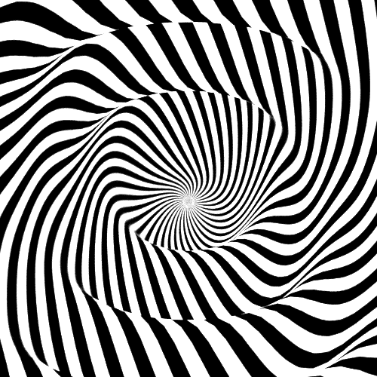
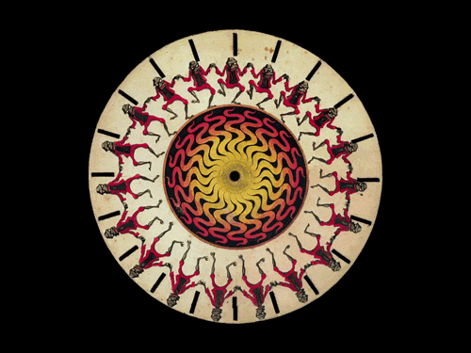
Persistence of vision is also known as an optical illusion that takes place when pictures are in motion.

Slide 6
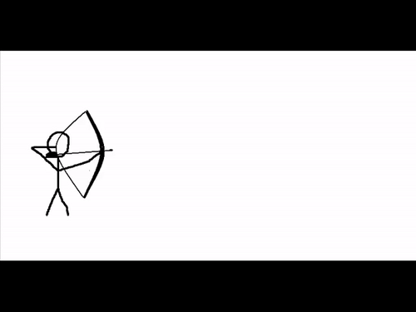
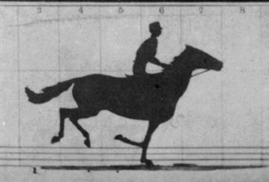
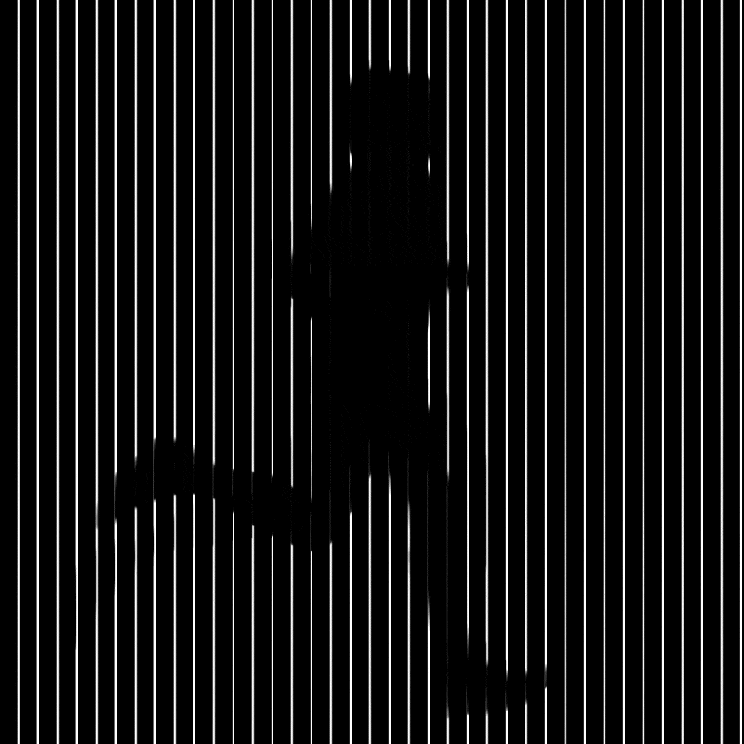
Application of a Thaumatrope

Slide 7
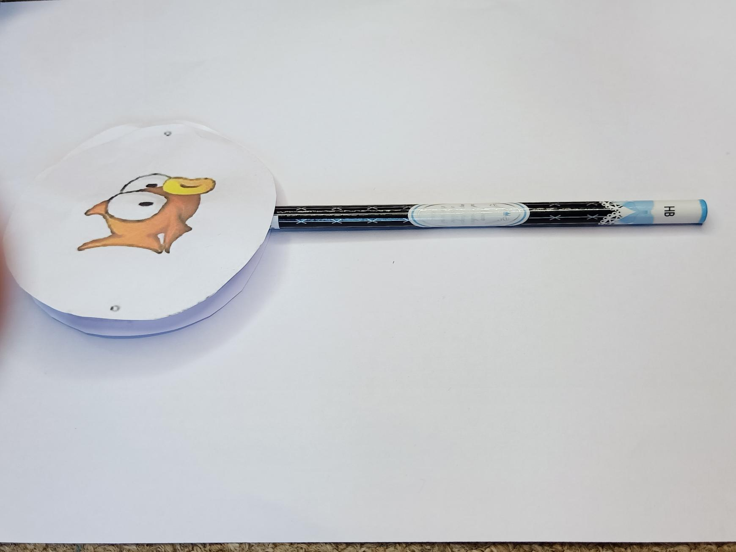
Let’s make our Thaumatrope

Slide 8

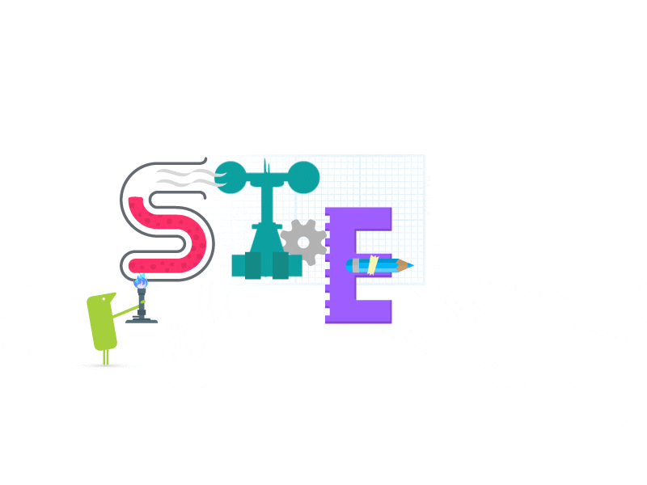

Slide 9


